Slide 1

Customer Service Automation Features
DYNAMICS 365

Slide 2

Mitch Milam
Dynamics CRM Architect
mitch@xrmcoaches.com
@mitchmilam
http://tinyurl.com/MitchMilamLinkedIn

Slide 3
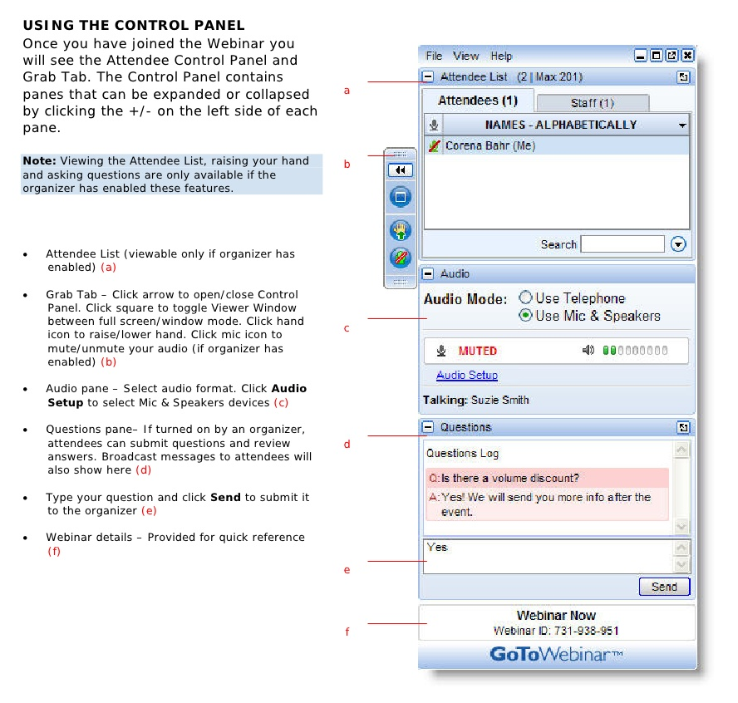
Webinar Housekeeping

Slide 4


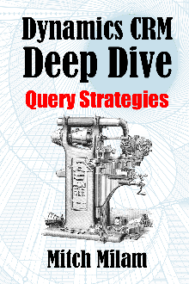
2017 Training Roadmap
Webinars
http://www.xrmcoaches.com/webinars
KnowledgeBits
http://www.xrmcoaches.com/knowledgebits
Learning Plans
http://www.xrmcoaches.com/freestuff
More Goodies
Practice tests
On–Demand video training
Instructor–led training
Books

Slide 5
Agenda
What we are discussing
Creating a Support Framework
Case Configuration
Queue Management
Case Creation Rules
Routing Rules
Working with Cases
Additional technical details
Phone Integration

Slide 6
Create a Support Framework

Slide 7
What is Your Target Audience?
Internal Customers
External Customers
Both

Slide 8
Define Your Support Channels
Phone
Email
Web Site
Social Media
Fax (yep, people still use those)
Walk-in
Form
Chat

Slide 9
Define Your Processes
Intake
Processing
Escalation
Resolution
Closure

Slide 10
Define Goals
What is important to your organization?
Create clear and concise:
Documentation
Procedures
Expectations
Ensure that everyone knows and understands the above

Slide 11
Tips
Don’t design in a vacuum
Involve the people using the system in the process of defining the system
DO NOT make the people fit the process. Make the process fit the people

Slide 12

Educate Your People

Slide 13
Configuration

Slide 14
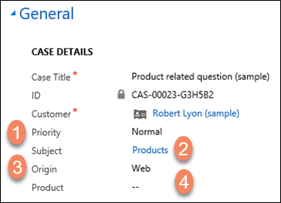
Case Details

Slide 15
Case Customization
Add fields are require to match your business
Configure forms and views to request and display relevant data
Configure fields and data to match your business

Slide 16
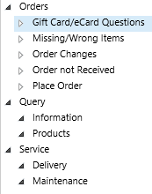
Subject Tree

Slide 17
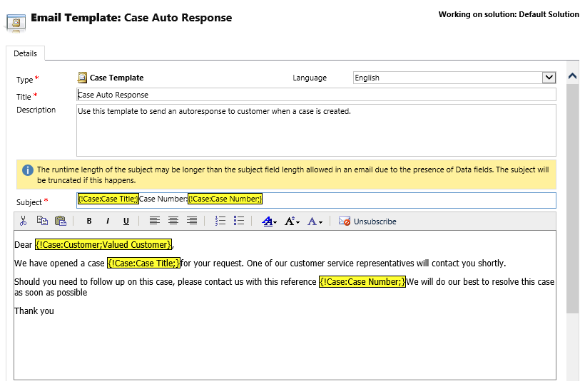
Email Templates

Slide 18
Email Templates
Review cases periodically and extract commonly requested:
Procedures
Requests for Information
FAQs
Create an Email Template for each
Remember: Templates are another maintenance point.
Don’t let them get stale or out of date

Slide 19
Queue Management

Slide 20
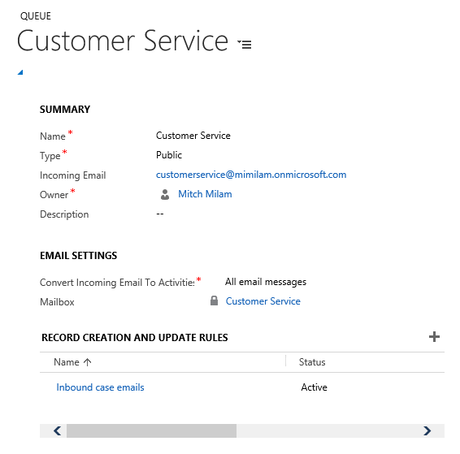
Queue Definition

Slide 21
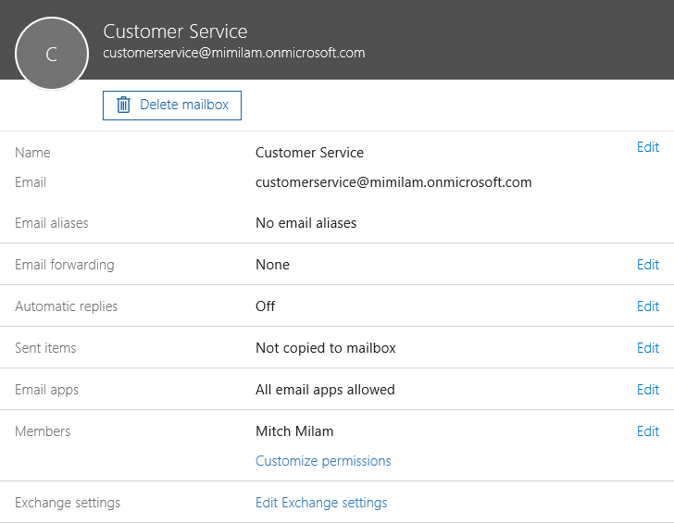
Shared Mailbox

Slide 22
Defining Queues
What is the normal work-flow or work-process for a case?
Can you clearly define:
Departments
Functionality Areas
Support Groups
Escalation Paths
Do you have one or more inbound support channels?

Slide 23
Queue Design Example
Customer Service
Sales
Registration
Product2
Product2
Questions
Product1
Internal
Tier 1
Tier 2
Escalation
Management

Slide 24
External-Facing
External (customerservice@mycompany.com)
Customer Service Queue
Product1

Slide 25
Internal Support
HelpDesk
Tier 1
Escalation

Slide 26
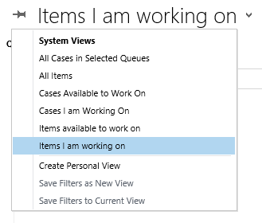
Default Queue Views

Slide 27
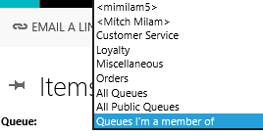
Queue Selection

Slide 28
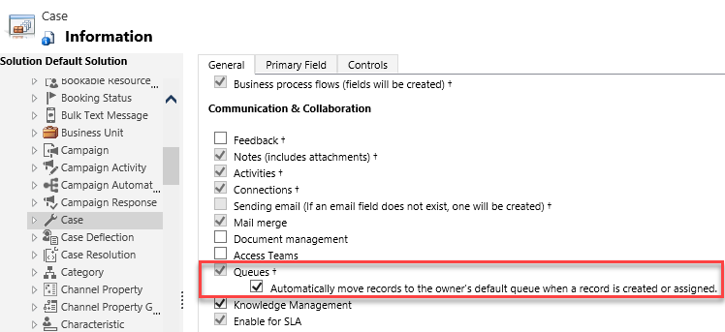
Technical Details
A Queue Item
Is a pointer to another CRM record
Entities
Must be Queue- Enabled

Slide 29
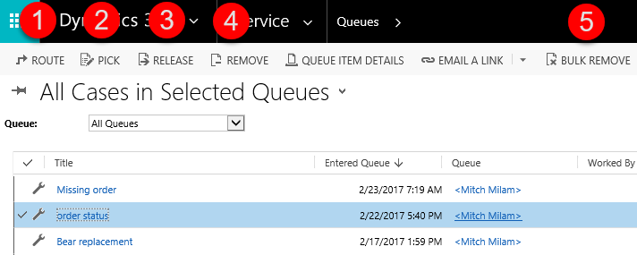
Queue Item Actions

Slide 30
Case Creation Rules

Slide 31
Why Automate Case Creation?
Saves time and energy
Can greatly increase productivity
Increases productivity and throughput

Slide 32
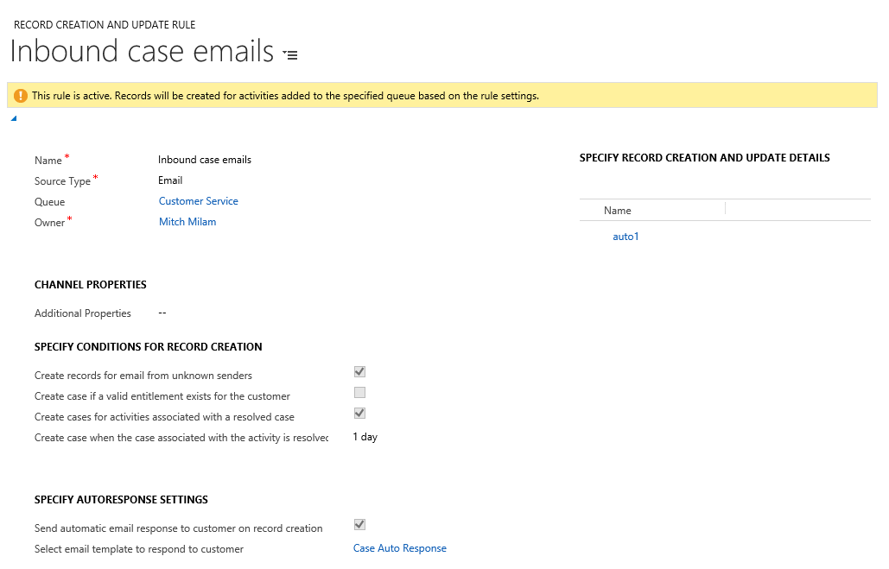
Rule Definition

Slide 33
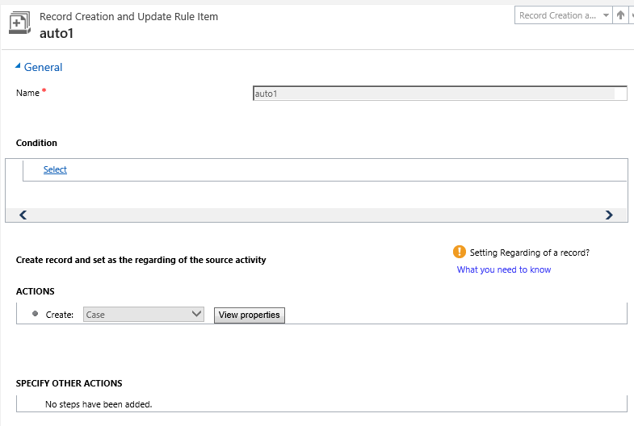
Rule Details

Slide 34
Routing Rules

Slide 35
Why Automate a Routing?
Saves time and energy
Prevents items from becoming “lost”
Increases productivity and throughput

Slide 36
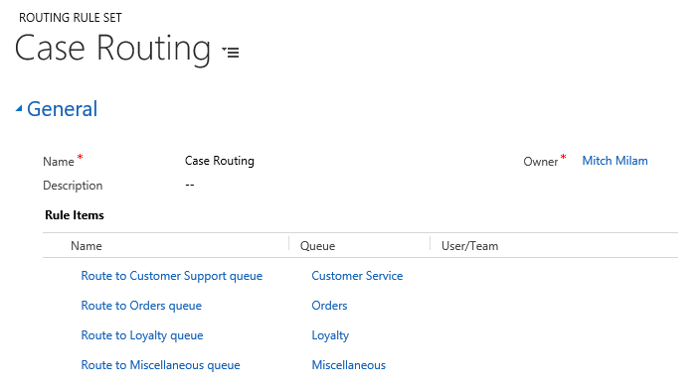
Routing Rule Definition

Slide 37
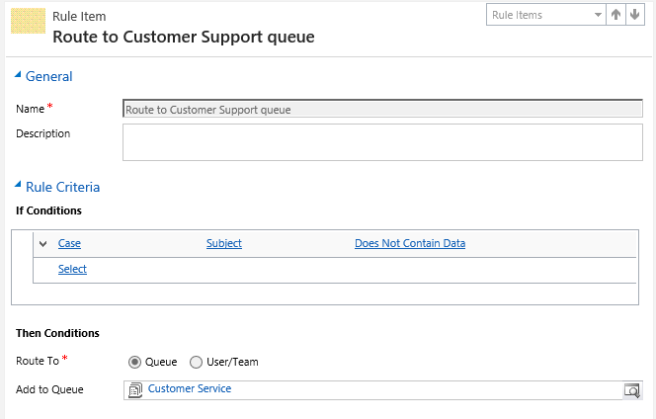
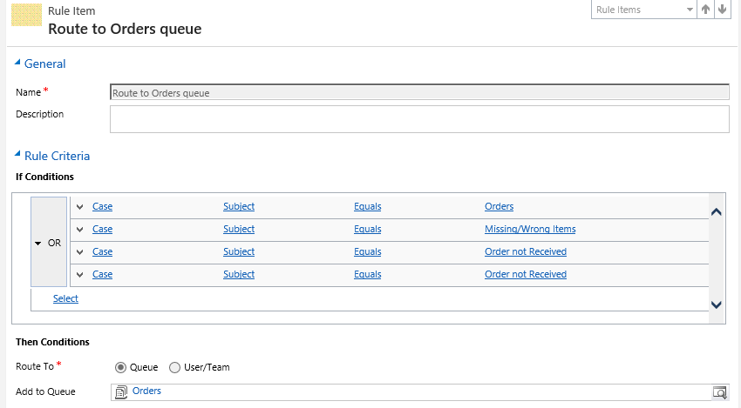

Slide 38
Working with Cases

Slide 39
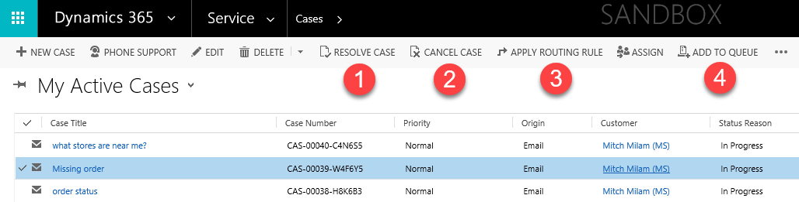
Case View Actions

Slide 40
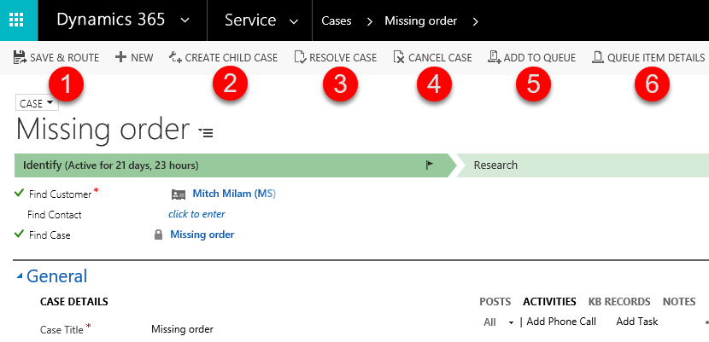
Case Form Actions

Slide 41
Case Granularity
Parent: Dynamics CRM Issue
Child: Verify web server components
Child: Verify network components
Child: Workstation checkup

Slide 42
Additional
Technical Details

Slide 43
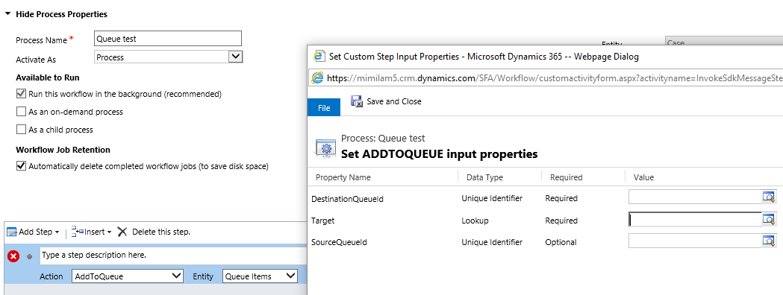
Processes and Queue Items
Dynamics 365

Slide 44
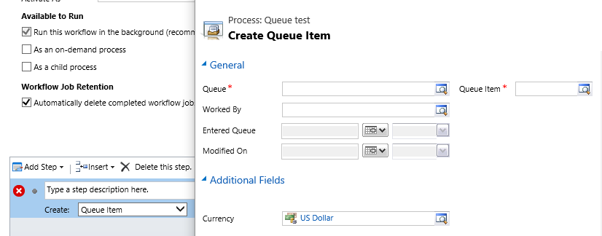
Processes and Queue Items
Dynamics CRM (2011-2016)

Slide 45
Phone Integration

Slide 46
ISV Solutions
Dynamics Telephony
http://www.dynamicstelephony.com
MSCRM-AddOns TelephoneIntegration
http://www.mscrm-addons.com/Products/TelephoneIntegration
SkypePop
https://www.skypepop.com

Slide 47
Productivity Gains
“Screen Pops” automatically display relevant records for selection by customer service rep
Save time performing a manual search
Automatically creates Phone Call Activity
Can be used to track phone call statistics

Slide 48
Review
What we discussed
Creating a Support Framework
Case Configuration
Queue Management
Case Creation Rules
Routing Rules
Working with Cases
Additional technical details
Phone Integration

Slide 49
Questions?

Slide 50
Thank You

